Slide 1

College of Computer and Information Sciences
Department of Computer Science
CSC 220: Computer Organization
Unit 11
Basic Computer Organization and Design

Slide 2
For the rest of the semester, we’ll focus on computer architecture: how to assemble the combinational and sequential components we’ve studied so far into a complete computer.
Today, we’ll start with the datapath, the part of the central processing unit (CPU) that does the actual computations.

Slide 3
An overview of CPU design
We can divide the design of our CPU into three parts:
The datapath does all of the actual data processing.
An instruction set is the programmer’s interface to CPU.
A control unit uses the programmer’s instructions to tell the datapath what to do.
Today we’ll look in detail at a processor’s datapath.
An ALU does computations, as we’ve seen before.
A limited set of registers serves as fast temporary storage.
A larger, but slower, random-access memory is also available.

Slide 4
What’s in a CPU?
ALU
Registers
A processor is just one big sequential circuit.
Some registers are used to store values, which form the state.
An ALU performs various operations on the data stored in the registers.

Slide 5
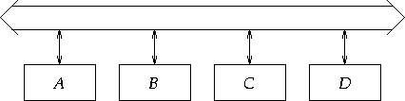
Micro-Ops Transfer Bus
A bus consists of a set of parallel data lines
To transfer data using a bus: connect the output of the source register to the bus; connect the input of the target register to the bus; when the clock pulse arrives, the transfer occurs

Slide 6
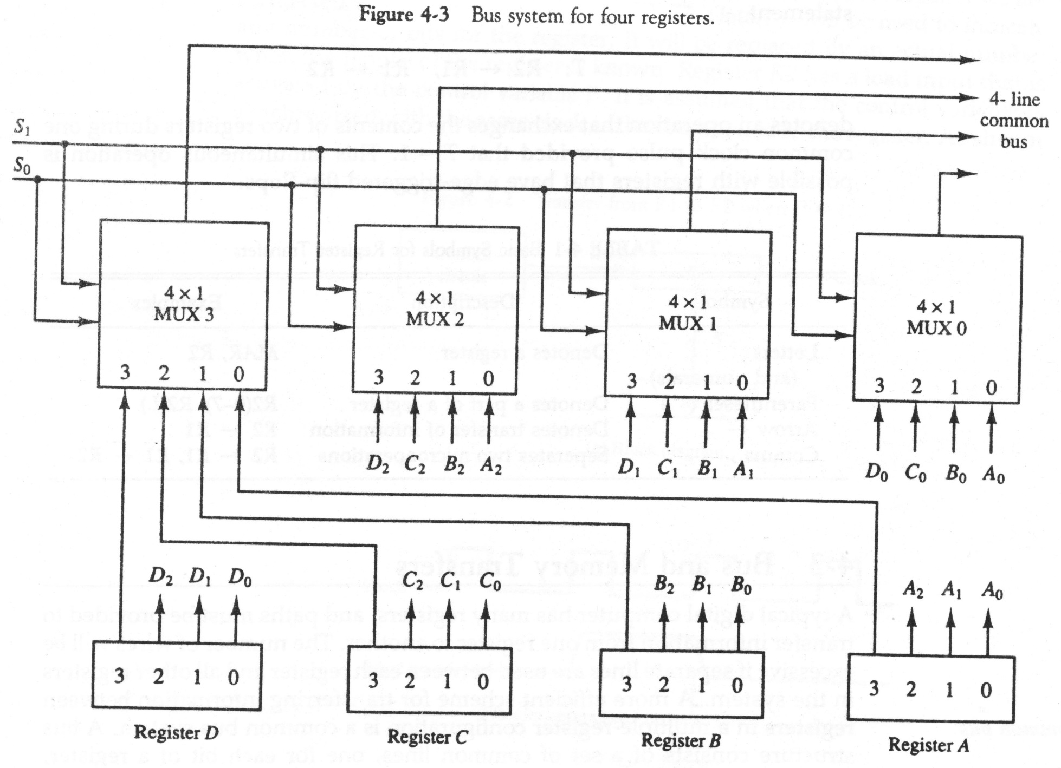
Bus and Memory transfers

Slide 7
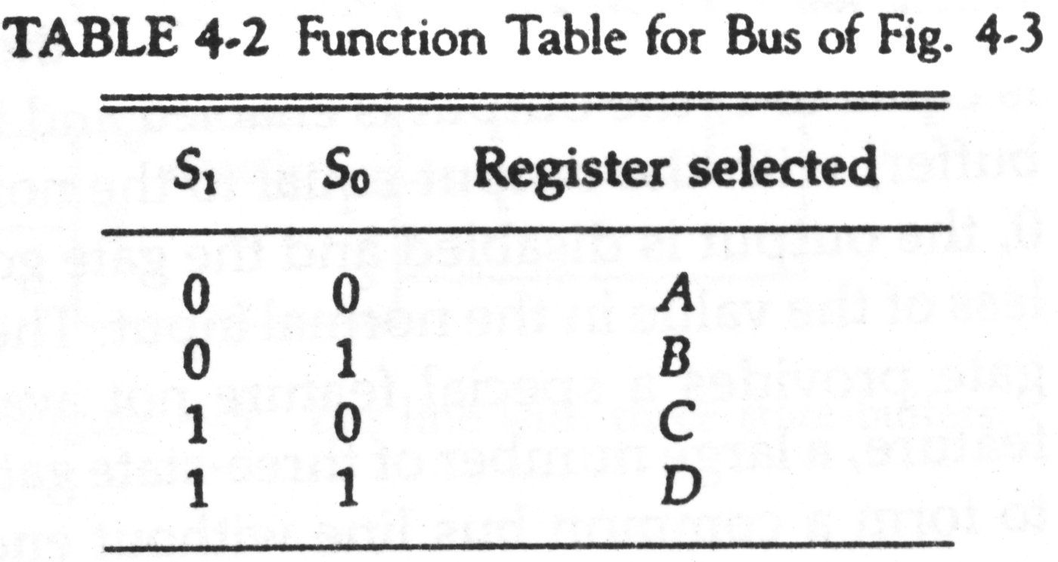



The content of register C is placed on the bus, and the content of the bus
is loaded into register A by activating its load control input.

Slide 8
Question
A digital computer has a common bus system for 16 registers of
32 bit each. The bus is constructed with multiplexers.
How many selection inputs are there is each multiplexer?
What size of multiplexers is needed?
How many multiplexers are there in the bus?

Slide 9
Register files
D
n
Modern processors contain a number of registers grouped together in a register file.
Much like words stored in a RAM, individual registers are identified by an address.
Here is a block symbol for a
2^{k} x n register file.
There are 2^{k} registers, so register addresses are k bits long.
Each register holds an n-bit word, so the data inputs and outputs are n bits wide.
D data
WR
Write
DA
k
D address
Register File
AA
k
A address
B address
k
BA
A data
B data
n
n
A
B

Slide 10
Accessing the register file
You can read two registers at once by supplying the AA and BA inputs. The data appears on the A and B outputs.
You can write to a register by using the DA and D inputs, and setting WR = 1.
These are registers so there must be a clock signal, even though we usually don’t show it in diagrams.
We can read from the register file at any time.
Data is written only on the positive edge of the clock.
D
n
D data
WR
Write
DA
k
D address
Register File
AA
k
A address
B address
k
BA
A data
B data
n
n
A
B

Slide 11
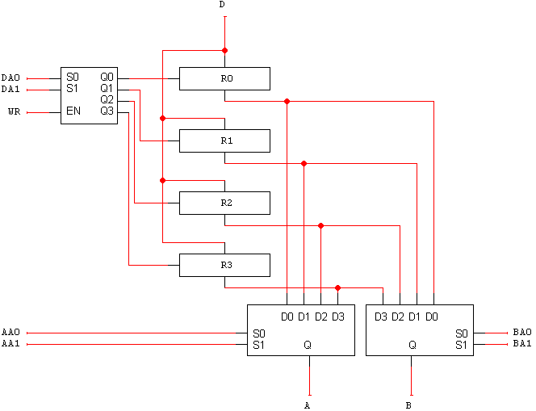
What’s inside the register file
Here’s a 4 x n register file. (We’ll assume a 2^{k} x n = 4 x n register file for all our examples.)
n
decoder
DA0 & DA1
Select the register
to write in
The n-bit 4-to-1 muxes select the two register file outputs A and B, based on the inputs AA and BA.
AA0 & AA1
BA0 & BA1
Select the register
to read from
Mux
Mux
n
n

Slide 12
Explaining the register file
The 2-to-4 decoder selects one of the four registers for writing. If WR = 1, the decoder will be enabled and one of the Load signals will be active.
The n-bit 4-to-1 muxes select the two register file outputs A and B, based on the inputs AA and BA.
We need to be able to read two registers at once because most arithmetic operations require two operands.
n
n
n

Slide 13
The all-important ALU
The main job of a central processing unit is to “process,” or to perform computations....remember the ALU from way back when?
We’ll use the following general block symbol for the ALU.
A and B are two n-bit numeric inputs.
FS is an m-bit function select code, which picks one of 2^{m} functions.
The n-bit result is called F.
Several status bits provide more
information about the output F:
V = 1 in case of signed overflow.
C is the carry out.
N = 1 if the result is negative.
Z = 1 if the result is 0.
n
n
A
B
m
FS
V
ALU
C
N
Z
F
n

Slide 14
ALU functions
For concrete examples, we’ll use the ALU as it’s presented in chapter 4.
The function select code FS is 4 bits long, but there are only 15 different functions here.
We use an alternative notation for AND and OR to avoid confusion with arithmetic operations.

Slide 15
My first datapath
Here is the most basic datapath.
The ALU’s two data inputs come from the register file.
The ALU computes a result, which is saved back to the registers.
WR, DA, AA, BA and FS are control signals. Their values determine the exact actions taken by the datapath— which registers are used and for what operation.
D data
WR
Write
DA
2
D address
Register File
AA
2
A address
B address
2
BA
A data
B data
n
n
A
B
FS
4
FS
V
ALU
C
N
n
Z
F

Slide 16
An example computation
Let’s look at the proper control signals for the operation below:
R0 ← R1 + R3
Set AA = 01 and BA = 11. This causes the contents of R1 to appear at A data, and the contents of R3 to appear at B data.
Set the ALU’s function select input FS = 0010 (A + B).
Set DA = 00 and WR = 1. On the next positive clock edge, the ALU result (R1 + R3) will be stored in R0.
D data
WR
Write
1
DA
D address
00
Register File
AA
A address
B address
BA
01
11
A data
B data
A
B
FS
FS
0010
V
ALU
C
N
Z
F

Slide 17
Two questions
D data
WR
Write
Four registers isn’t a lot. What if we need more storage?
Who exactly decides which registers are read and written and which ALU function is executed?
DA
D address
Register File
AA
A address
B address
BA
A data
B data
A
B
FS
FS
V
ALU
C
N
Z
F

Slide 18
We can access RAM also
Here’s a way to connect RAM into our existing datapath.
To write to RAM, we must give an address and a data value.
These will come from the registers. We connect A data to the memory’s ADRS input, and B data to the memory’s DATA input.
Set MW = 1 to write to the RAM. (It’s called MW to distinguish it from the WR write signal on the register file.)
n
D data
WR
Write
DA
D address
Register File
AA
A address
B address
BA
A data
B data
RAM
n
ADRS
n
DATA
OUT
+5V
CS
A
B
MW
WR
FS
FS
1
V
ALU
C
N
Z
F
n
D0
n
Q D1
S
MD
MW = 1
to write to the RAM

Slide 19
Reading from RAM
To read from RAM, A data must supply the address.
Set MW = 0 for reading.
The incoming data will be sent to the register file for storage.
This means that the register file’s D data input could come from either the ALU output or the RAM.
A mux MD selects the source for the register file.
When MD = 0, the ALU output can be stored in the register file.
When MD = 1, the RAM output is sent to the register file instead.
n
D data
WR
Write
DA
D address
Register File
AA
A address
B address
BA
A data
B data
RAM
n
ADRS
n
DATA
OUT
+5V
CS
A
B
MW
WR
FS
FS
0
V
ALU
C
N
Z
F
n
D0
n
Q D1
S
MD
Mux

Slide 20
Notes about this setup
n
We now have a way to copy data between our register file and the RAM.
Notice that there’s no way for the ALU to directly access the memory—RAM contents must go through the register file first.
Here the size of the memory is limited by the size of the registers; with n-bit registers, we can only use a 2^{n} x n RAM.
D data
WR
Write
DA
D address
Register File
AA
A address
B address
BA
A data
B data
RAM
n
ADRS
n
DATA
OUT
+5V
CS
A
B
MW
WR
FS
FS
V
ALU
C
N
Z
F
n
D0
n
Q D1
S
MD

Slide 21
Memory transfer notation
In our transfer language, the contents at random access memory address X are denoted M[X]. For example:
The first word in RAM is M[0].
If register R1 contains an address, then M[R1] are the contents of that address.
The M[ ] notation is like a pointer dereference operation in C or C++.

Slide 22
Example sequence of operations
Here is a simple series of register transfer instructions:
R3 ← M[R0]
R3 ← R3 + 1
M[R0] ← R3
This just increments the contents at address R0 in RAM.
Again, our ALU only operates on registers, so the RAM contents must first be loaded into a register, and then saved back to RAM.
R0 is the first register in our register file. We’ll assume it contains a valid memory address.
How would these instructions execute in our datapath?
M[R0] ← M[R0] + 1 =

Slide 23
R3 ← M[R0]
AA should be set to 00, to read register R0.
The value in R0 will be sent to the RAM address input, so M[R0] appears as the RAM output OUT.
MD must be 1, so the RAM output goes to the register file.
To store something into R3, we’ll need to set DA = 11 and WR = 1.
MW should be 0, so nothing is accidentally changed in RAM.
Here, we did not use the ALU (FS) or the second register file output (BA).
n
1
D data
WR
Write
DA
D address
11
Register File
AA
A address
B address
BA
00
A data
B data
RAM
n
ADRS
n
DATA
OUT
+5V
CS
A
B
MW
WR
FS
FS
0
V
ALU
C
N
Z
F
n
D0
n
Q D1
S
MD
1
MW = 1
to write to the RAM
MW = 0
to read from the RAM

Slide 24
R3 ← R3 + 1
AA = 11, so R3 is read from the register file and sent to the ALU’s A input.
FS needs to be 0001 for the operation A + 1. Then, R3 + 1 appears as the ALU output F.
If MD is set to 0, this output will go back to the register file.
To write to R3, we need to make DA = 11 and WR = 1.
Again, MW should be 0 so the RAM isn’t inadvertently changed.
We didn’t use BA.
n
1
D data
WR
Write
DA
D address
11
Register File
AA
A address
B address
BA
11
A data
B data
RAM
n
ADRS
n
DATA
OUT
+5V
CS
0001
A
B
MW
WR
FS
FS
0
V
ALU
C
N
Z
F
n
D0
n
Q D1
S
MD
0

Slide 25
M[R0] ← R3
n
Finally, we want to store the contents of R3 into RAM address R0.
Remember the RAM address comes from “A data,” and the contents come from “B data.”
So we have to set AA = 00 and BA = 11. This sends R0 to ADRS, and R3 to DATA.
MW must be 1 to write to memory.
No register updates are needed, so WR should be 0, and MD and DA are unused.
We also didn’t use the ALU, so FS was ignored.
0
D data
WR
Write
DA
D address
Register File
AA
A address
B address
BA
00
11
A data
B data
RAM
n
ADRS
n
DATA
OUT
+5V
CS
A
B
MW
WR
FS
FS
1
V
ALU
C
N
Z
F
n
D0
n
Q D1
S
MD

Slide 26
Constant in
One last refinement is the addition of a Constant input.
The modified datapath is shown on the right, with one extra control signal MB.
NOT R0, R1 R0 ← R1’
ADD R3, R3, #1 R3 ← R3 + 1
SUB R1, R2, #5 R1 ← R2 - 5
D data
WR
Write
DA
D address
Register File
AA
A address
B address
BA
A data
B data
Constant
MB
S D1 D0
Q
RAM
ADRS
DATA
OUT
+5V
CS
A
B
MW
WR
FS
FS
V
ALU
C
N
Z
F
D0
Q D1
S
MD

Slide 27
Summary
The datapath is the part of a processor where computation is done.
The basic components are an ALU, a register file and some RAM.
The ALU does all of the computations, while the register file and RAM provide storage for the ALU’s operands and results.
Various control signals in the datapath govern its behavior.
Next week, we’ll see how programmers can give commands to the processor, and how those commands are translated in control signals for the datapath.

